Slide 1
Long-Term Real-Time Network Traffic Flow Prediction Using LSTM Recurrent Neural Network
Cox Communication
Wei Cai
September 11th, 2019

Slide 2
What to expect
We will …
Provide an overview of what Long Short-Term Memory model is and the difference in internal structure of many-to-one and many-to-many models
Illustrates its flexibility and relevance to generalize time series past pattern and predict for future
Propose to add a sampling scheme to many-to-many deep neural network

Slide 3
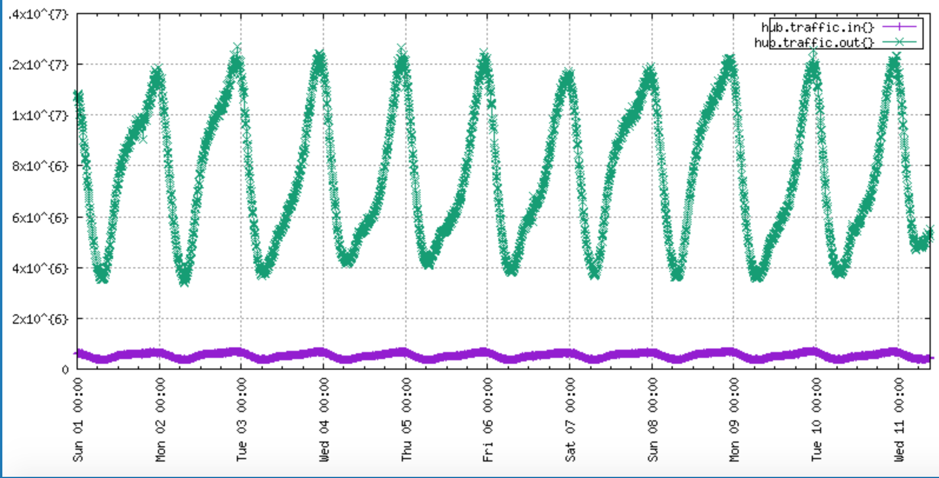
A Real-life Use Case
input.json
658.7 MB

Slide 4
In a nutshell
The Long Short-Term Memory (LSTM) network is a type of Recurrent Neural Network, but has a unique formulation that allows it to train more effectively.
A typical RNN (Source: http://colah.github.io/posts/2015-08-Understanding-LSTMs/)
A LSTM unit (Source : http://colah.github.io/posts/2015-08-Understanding-LSTMs)

Slide 5
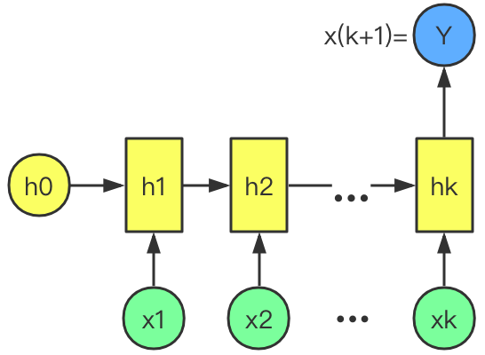
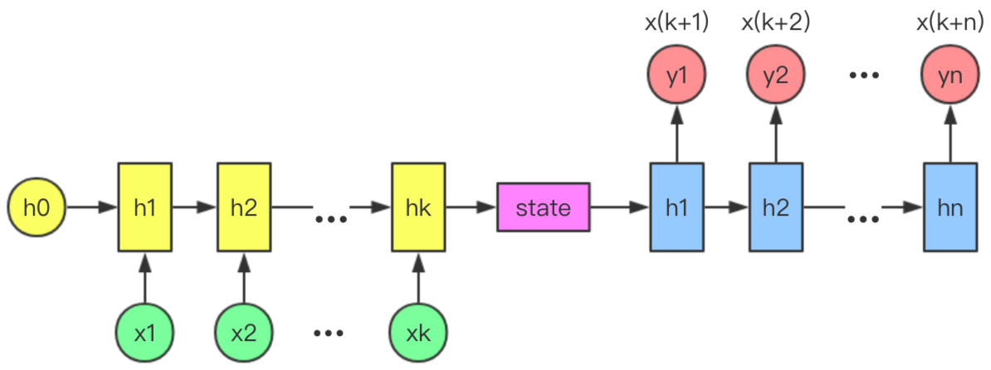
LSTM: many-to-one vs. many-to-many
Source Embedding
Target Embedding
Network architecture of many-to-one LSTM
Network architecture of many-to-many LSTM

Slide 6
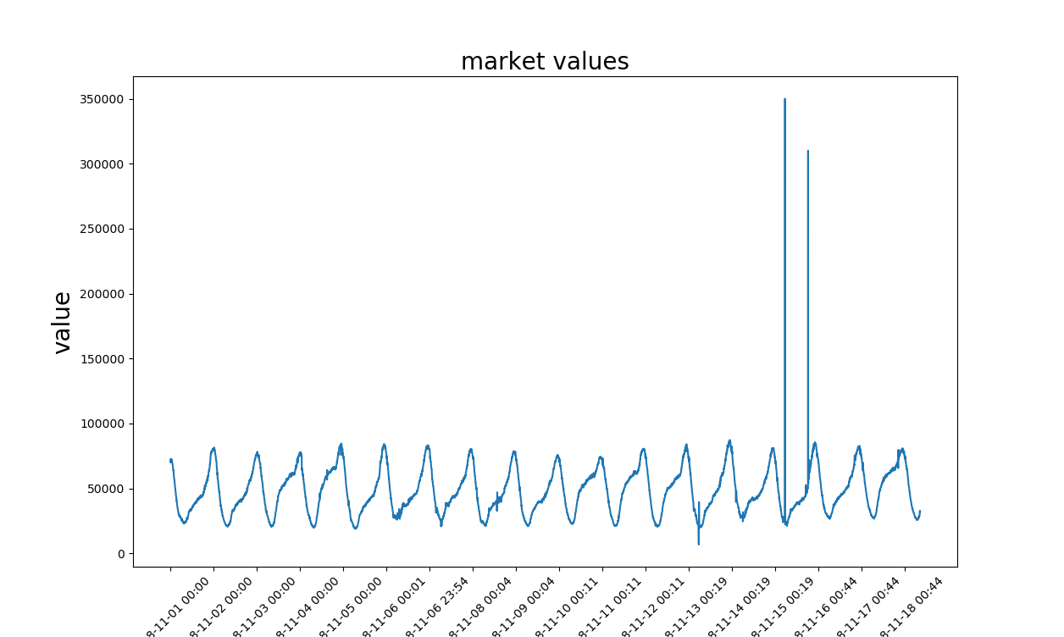
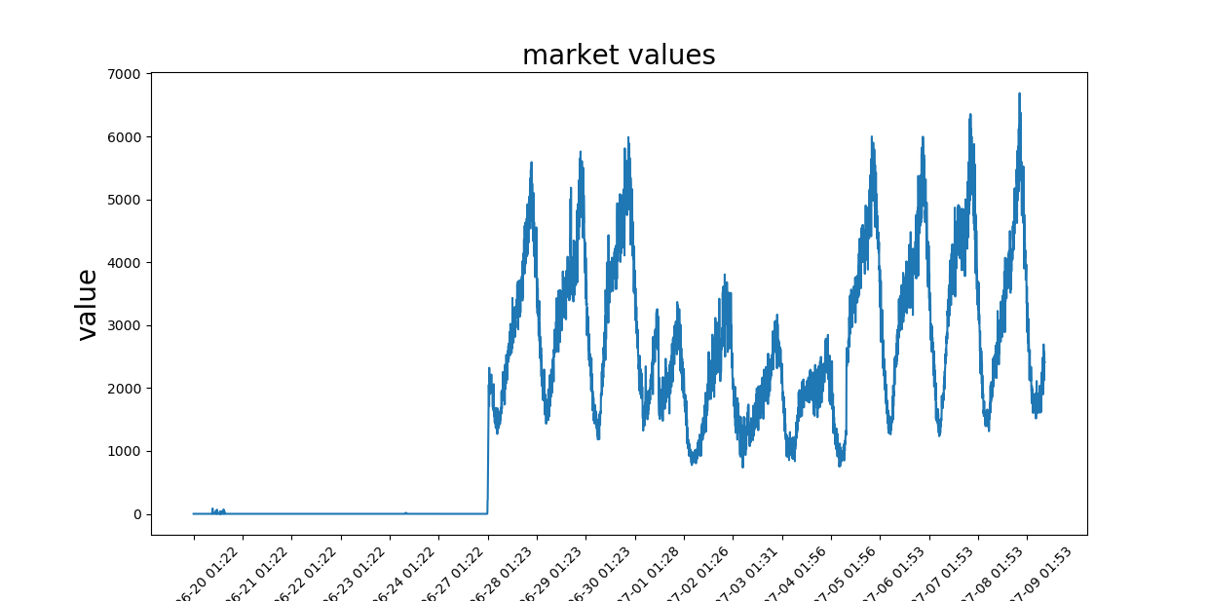
LSTM: many-to-one
Atucal data points of market “chndmcdl”
Atucal data points of market “ btnrerwn”

Slide 7
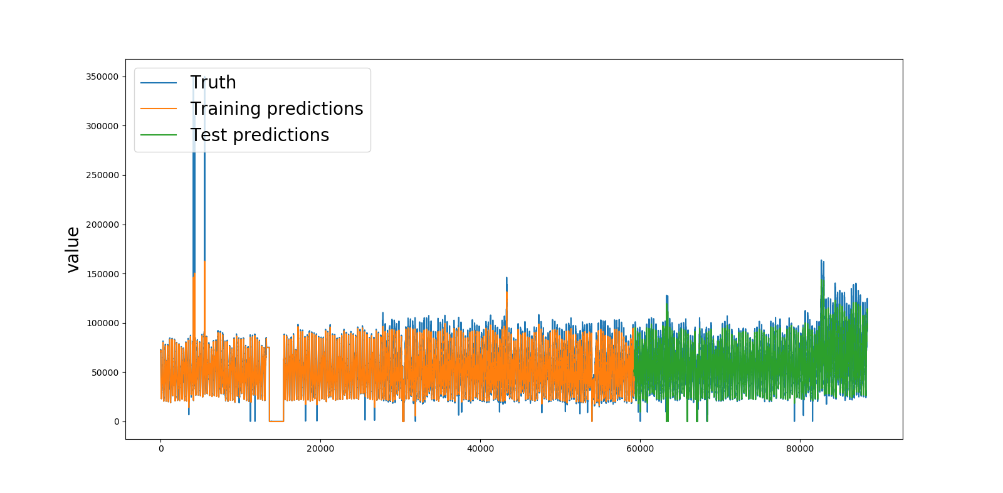
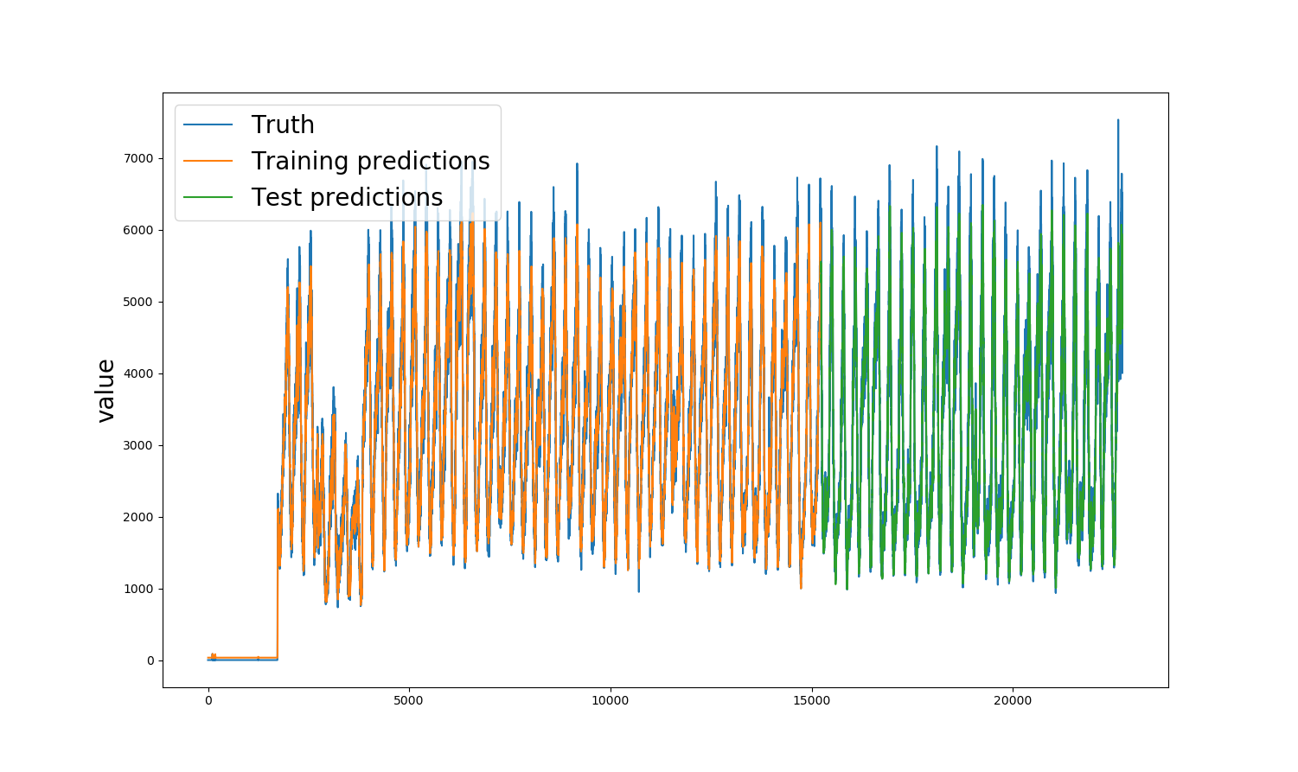
LSTM: many-to-one
Prediction of market “chndmcdl”
training RMSE: 4105.4180 testing RMSE: 4465.5039
Prediction of market “btnrerwn”
training RMSE: 270.5595 testing RMSE: 325.1492

Slide 8
LSTM: many-to-many with a sampling schema
X(ke1)1X(ke1)2
X(k+1)3
.
.
.
X(ke2)1X(ke2)2
X(k+2)3
.
.
.
X(ken)1X(ken)2
X(k+n)3
.
.
.
…
sampling
Source Embedding
Target Embedding
sampling
X11
X12
X13
.
.
.
X21
X22
X23
.
.
.
…
Xk1
Xk2
Xk3
.
.
.

Slide 9
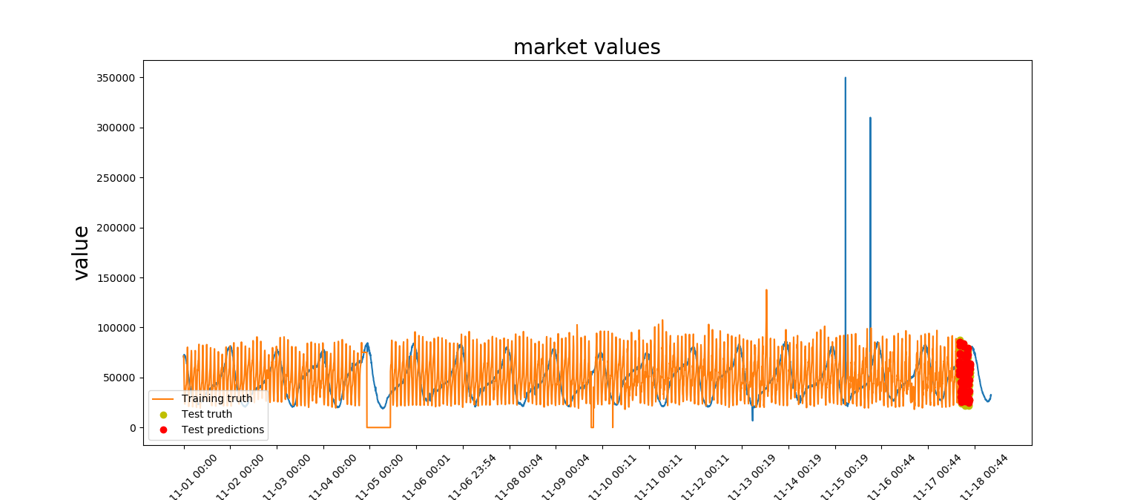
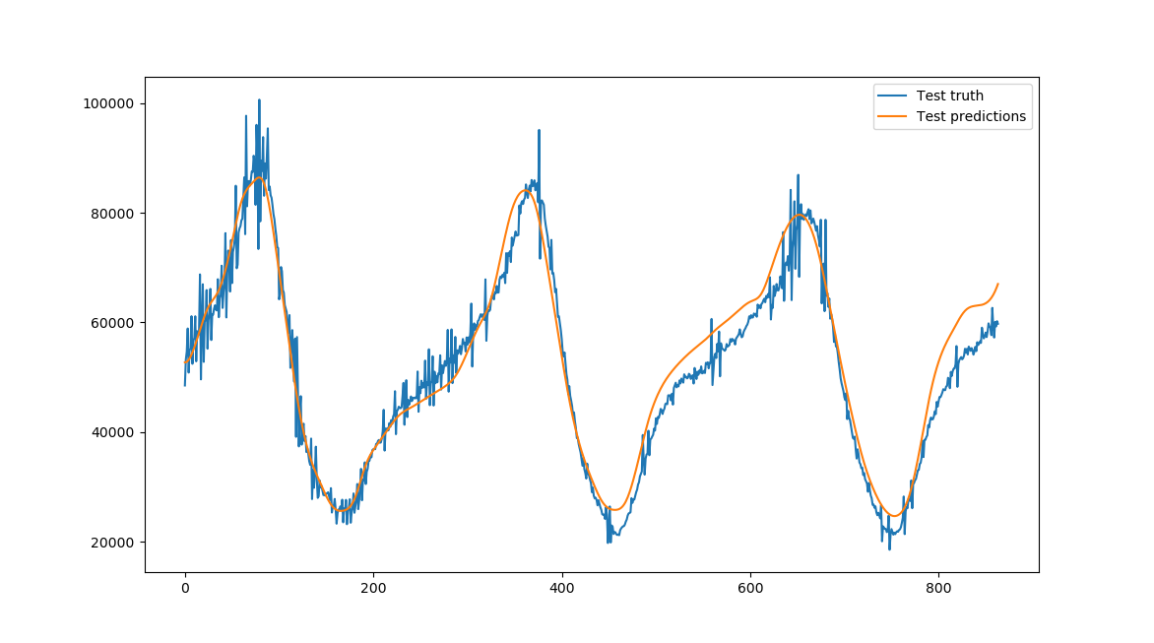
LSTM: many-to-many with and without a sampling schema
Prediction of market “chndmcdl” before interpolation
Prediction of market “chndmcdl” after interpolation
testing RMSE: 4386.9658
testing RMSE: 3897.6734

Slide 10
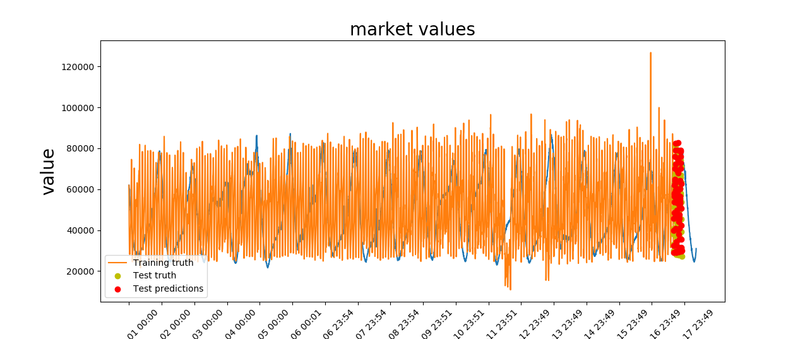
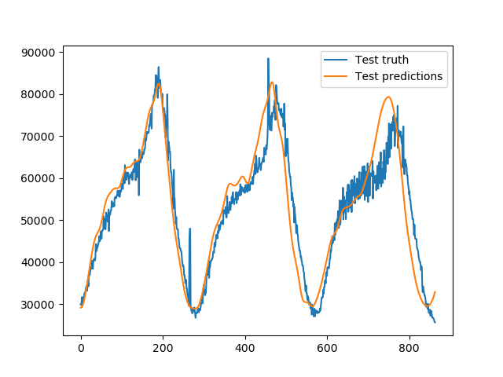
LSTM: many-to-many with and without a sampling schema
Prediction of market “bntrbntr” before interpolation
Prediction of market “bntrbntr” after interpolation
testing RMSE: 5855.8790
testing RMSE: 5135.6238

Slide 11
LSTM: many-to-many with a sampling schema
Decrease in Model Perplexity
Increase in convergence speed
Less prone to overfitting
Denoise the impact of anomaly

Slide 12
Conclusion and Future Work
Not all data points matter equally in the duration of training
try other sampling schema (i.e., importance) to accelerate the training and compare the difference in speed and performance
Sampling schema can be investigated together with other techniques to speed up training

Slide 13
Questions?
Can also email questions to wei.cai@cox.com

